Slide 1
Middleware Technologies for Systems Integration
SE495: Software and Systems Integration

Slide 2
Outline
Introduction to business process modeling
BPMN notation and elements
Process analysis and optimization
Capturing integration requirements
Tools for business process modeling

Slide 3
Introduction

Slide 4
Business Process Modeling
Business process modeling (BPM) is the activity of representing a business process, or a sequence of related activities that produce a specific outcome, using graphical and/or textual notations.
BPM is used to visualize, analyze, and improve the efficiency and effectiveness of business processes.
It involves identifying the inputs, outputs, tasks, decisions, and interactions involved in a process and representing them in a way that is easy to understand and communicate.

Slide 5
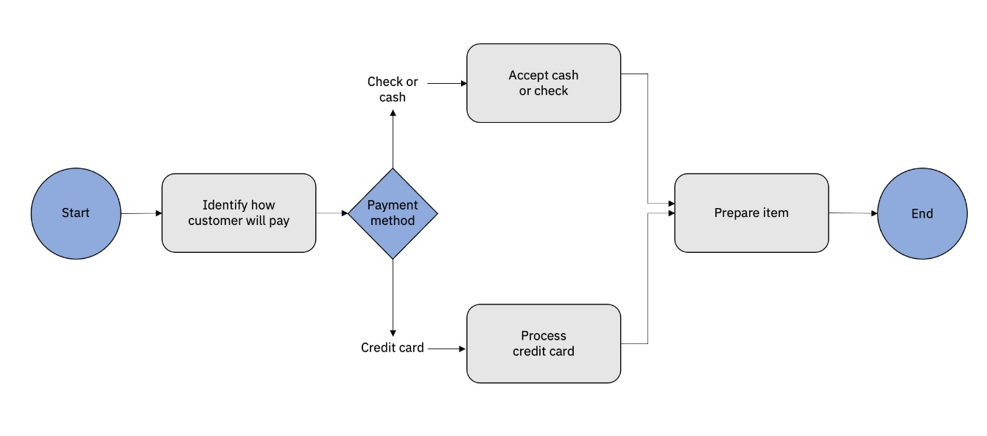
Business Process Modeling
BPM is often used in the context of business process management (BPMN), which involves the design, implementation, and monitoring of business processes to achieve organizational goals.
BPM can help organizations to identify inefficiencies and bottlenecks in their processes, streamline workflows, reduce costs, and improve quality and customer satisfaction.

Slide 6
Business Process Modeling
There are various techniques and tools used in BPM, including process mapping, flowcharting, and simulation.
BPMN is a widely used standard for modeling business processes, with a notation that is easily understood by both technical and non-technical stakeholders.

Slide 7
The Benefits of BPMN
Standard notation maintained by OMG – independent entity (no vendor lock-in)
Common language for various groups: business users, business analysts, technical implementation specialists etc.
Basic BPMN is similar to flowcharts, so it is easy to learn
However, it allows also to capture more technical details e.g. via event handling
BPMN 2.0 contains interchange mechanism
BPMN 2.0 contains attributes and logic to support process automation

Slide 8
Importance
Increased Efficiency
BPM helps organizations identify inefficiencies in their processes, which can then be streamlined and optimized. By mapping out processes, businesses can identify bottlenecks, redundancies, and areas that need improvement. This leads to faster, more efficient processes and less waste.
Improved Quality
By analyzing processes and identifying areas for improvement, BPM can help organizations improve the quality of their products and services. By streamlining processes, businesses can reduce the likelihood of errors and improve consistency, which leads to higher-quality products and services.

Slide 9
Importance
Better Decision Making
BPM provides a structured approach to decision-making. By mapping out processes and identifying key decision points, organizations can make better-informed decisions that are based on data and analysis rather than intuition.
Greater Agility
BPM can help organizations respond more quickly to changes in their environment. By having a clear understanding of their processes, businesses can more easily identify areas where changes are needed and make adjustments as needed.

Slide 10
Importance
Improved Customer Experience
By streamlining processes and improving quality, organizations can improve the customer experience. This leads to greater customer satisfaction, loyalty, and retention.
Greater Transparency
BPM provides a clear view of how processes work within an organization. This helps employees better understand their roles and responsibilities, and it helps management identify areas where additional training or resources may be needed.

Slide 11
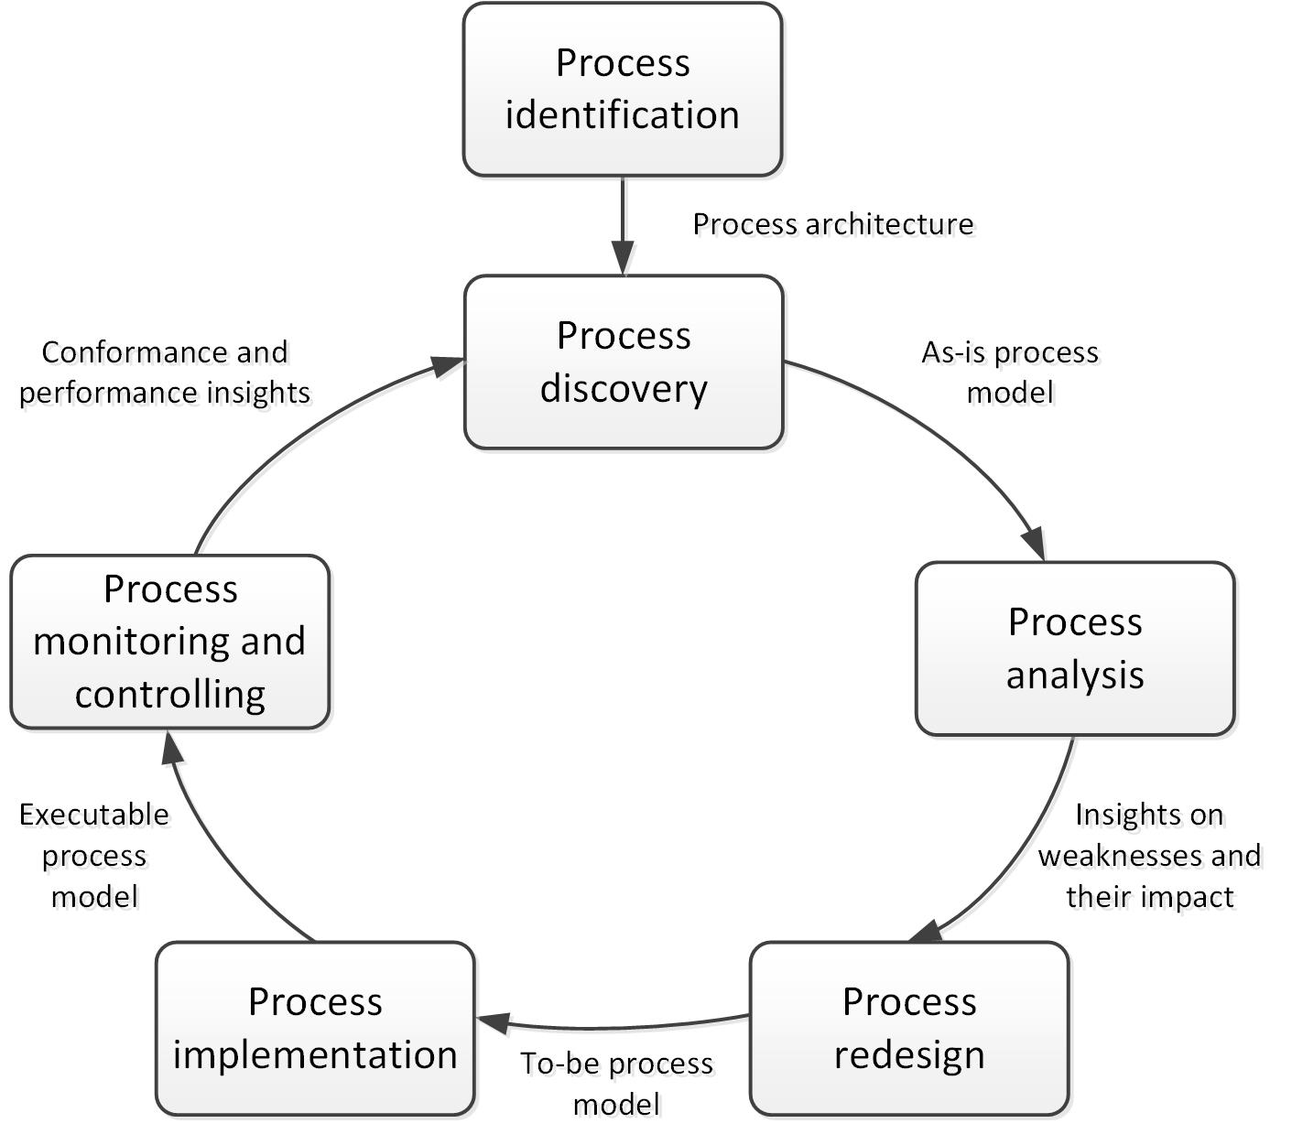
The Business Process Modeling Lifecycle

Slide 12
The Business Process Modeling Lifecycle
The Business Process Modeling (BPM) lifecycle is a series of steps that organizations follow to improve their business processes.
The six stages of the BPM lifecycle are:
Identification
In this stage, organizations identify the processes that need improvement. This involves reviewing existing processes, identifying areas of inefficiency, and determining which processes are critical to the success of the organization.
Discovery
In this stage, organizations gather additional information about the processes identified in the previous stage. This may involve interviewing employees, observing processes, and collecting data to gain a better understanding of how the processes work.

Slide 13
The Business Process Modeling Lifecycle
Analysis
In this stage, organizations analyze the data collected during the discovery stage to identify areas for improvement. This may involve using process maps, flowcharts, or other tools to visualize the processes and identify bottlenecks, redundancies, and areas of waste.
Redesign
In this stage, organizations redesign the processes to make them more efficient and effective. This may involve eliminating unnecessary steps, automating certain tasks, or restructuring the process to improve workflow.

Slide 14
The Business Process Modeling Lifecycle
Implementation
In this stage, organizations implement the redesigned processes. This may involve providing training to employees, updating software systems, or making other changes to the organization's infrastructure to support the new processes.
Monitoring
In this stage, organizations monitor the new processes to ensure they are working as intended. This may involve collecting data to measure the performance of the new processes, identifying areas where further improvements can be made, and making adjustmentsas needed to ensure the processes continue to meet the organization's goals.

Slide 15
The Business Process Modeling Lifecycle
The BPM lifecycle is an iterative process, meaning that the steps may need to be revisited and repeated as needed to ensure that the processes are continuously improved.
By following the BPM lifecycle, organizations can identify areas for improvement, make changes, and monitor their progress to ensure they are meeting their goals.
This leads to increased efficiency, improved quality, and a more agile organization that is better equipped to respond to changes in the business environment.

Slide 16
BPMN notation and elements

Slide 17

BPMN from a Mile Away
A BPMN process model is a graph consisting (principally) of four types of elements:

Slide 18
Order Management Process in BPMN
A First Attempt at Process Modeling
Notes:
This simple Order Management process is triggered by the reception of a purchase order from a customer. The purchase order has to be checked against the stock re the availability of the product(s) requested. Depending on stock availability the purchase order may be confirmed or rejected. If the purchase order is confirmed, the goods requested are shipped and an invoice is sent to the customer.
In this diagram, plain gateways are used to denote points were the flow of control splits into multiple paths, and point where multiple paths converge into a single one. We can note that the first gateway in this diagram, denotes a point where one among multiple paths needs to be chosen. Meanwhile, the second gateway denotes a point where two distinct paths need to be executed in parallel. Intuitively, it would make sense to distinguish between these two cases, that is, the case where one among many paths is chosen, and the case where multiple parallel paths are taken. In BPMN, this is shown by means of icons in the gateways. An “x” symbol in a gateway with multiple outgoing arcs indicates that one of multiple paths is taken. Such gateways are called exclusive gateways (remember that the “x” stands for exclusive). Meanwhile, a “+” symbol in a gateways with multiple outgoing arcs denotes that multiple parallel paths are executed. So the above diagram should be re-written as shown later…

Slide 19
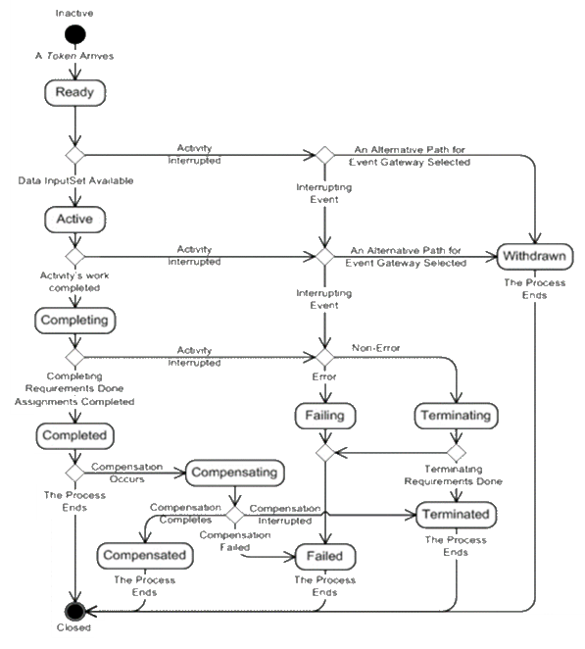
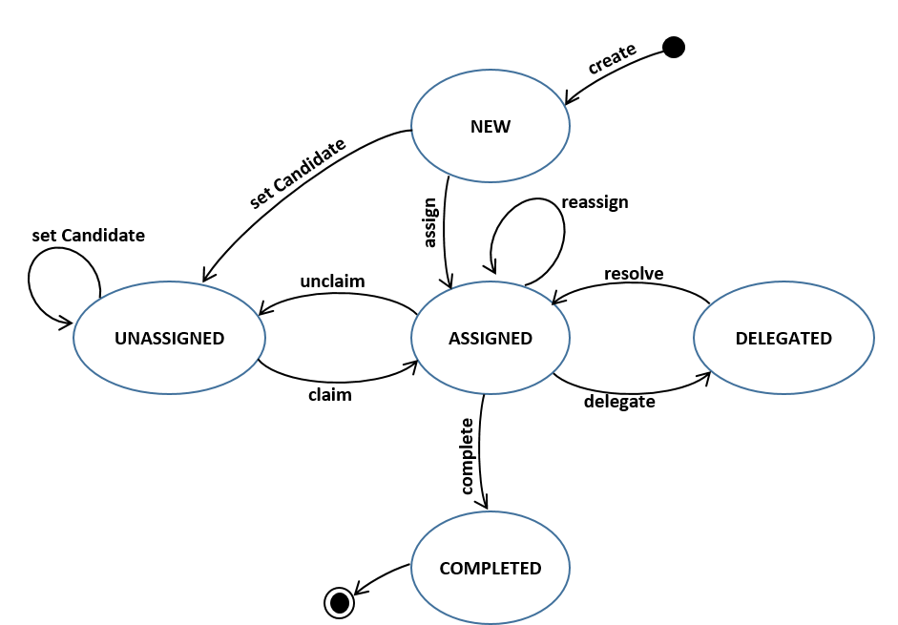
BPMN is a Token Based Language
iBPMS Specification

Slide 20

Order Management Process in BPMN
A First Attempt at Process Modeling

Slide 21
A Bit More on Gateways…
Exclusive Decision / Merge
Indicates locations within a business process where the sequence flow can take two or more alternative paths.
Only one of the paths can be taken.
Depicted by a diamond shape that may contain a marker that is shaped like an “X”.
Parallel Fork / Join
Provide a mechanism to synchronize parallel flow and to create parallel flow.
Depicted by a diamond shape that must contain a marker that is shaped like a plus sign.

Slide 22
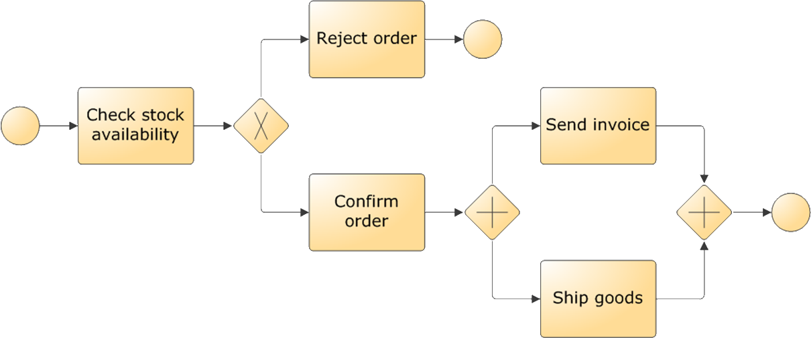
Order Management Process in BPMN
A Revised Model
Notes:
It is worth emphasizing here that activities located in two parallel paths do not need to be performed simultaneously. For example, “Send invoice” and “Ship goods” need not occur both at the same time, although due to a cosmic coincidence, they could happen at the same time. Instead, it might happen that first the invoice is sent and later the goods are shipped. Or things may happen in the reverse order.

Slide 23




Overview of all Gateways
Exclusive (XOR)
Exclusive decision take one branch
Exclusive merge Proceed when one branch has completed
Parallel
(AND)
Parallel split take all branches
Inclusive
(OR)
Inclusive decision take one or several branches depending on conditions
Inclusive merge proceed when all active incoming branches have completed
Parallel join proceed when all incoming branches have completed
Complex Gateway
Split and Join are governed by a Rule.

Slide 24
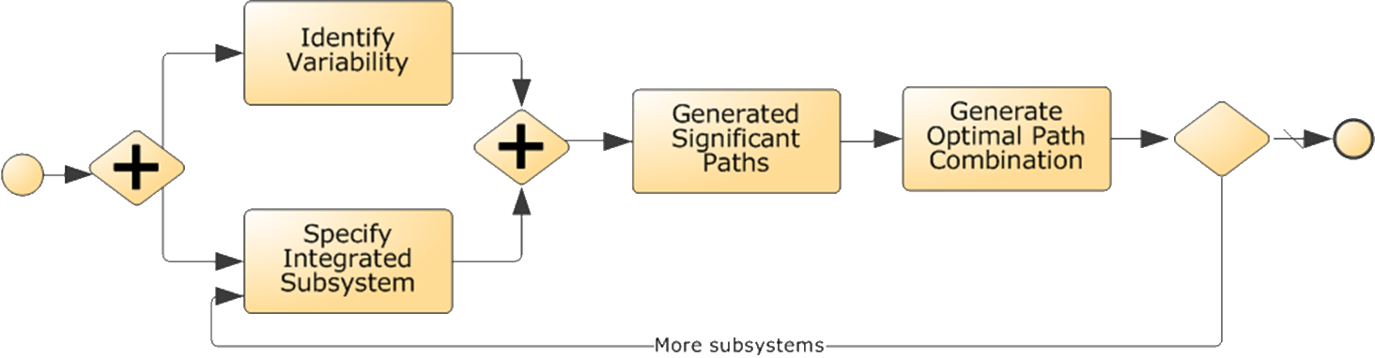
What is Wrong with this Model?

Slide 25
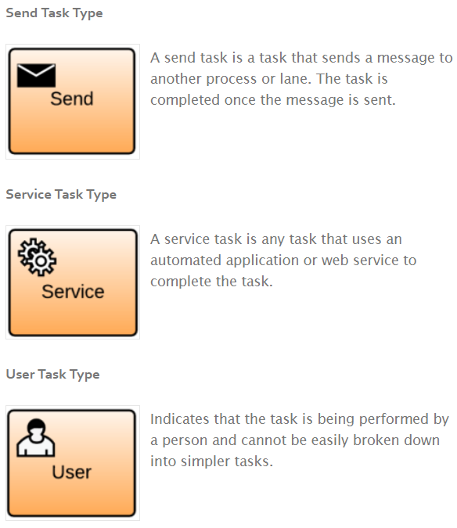
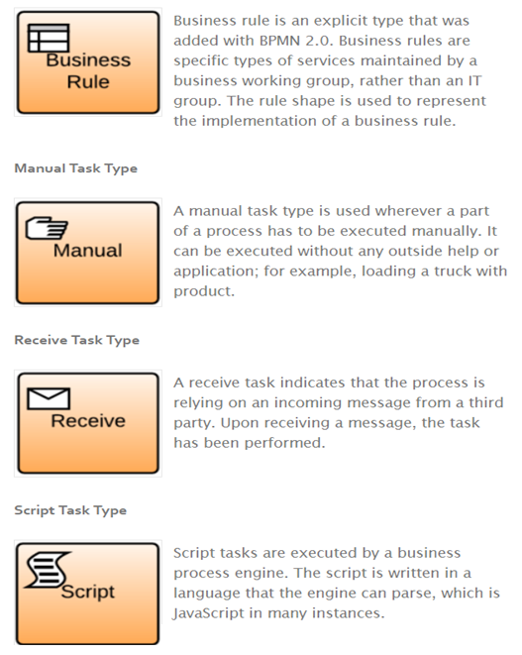
Types of Tasks
Business Rule Task Type

Slide 26
Organizational Elements
Two basic abstractions:
Resource: Human actor or equipment (e.g. printer) that is required to perform an activity
Resource class: Set of resources with shared characteristics, e.g. Clerk, Manager, Insurance Officer
A resource class may be a:
Role (skill, competence, qualification) Classification based on what a resource can do or is expected to do.
Group (department, team, office, organizational unit) Classification based on the organization’s structure.

Slide 27
Resource Modelling
In BPMN, resource classes are captured using:
Pools – independent organizational entities, e.g.
Customer, Supplier, East-Tallinn Hospital, Tartu Clinic
Lanes – resource classes in the same organizational space and sharing common systems
Sales Department, Marketing Department
Clerk, Manager, Engineer

Slide 28
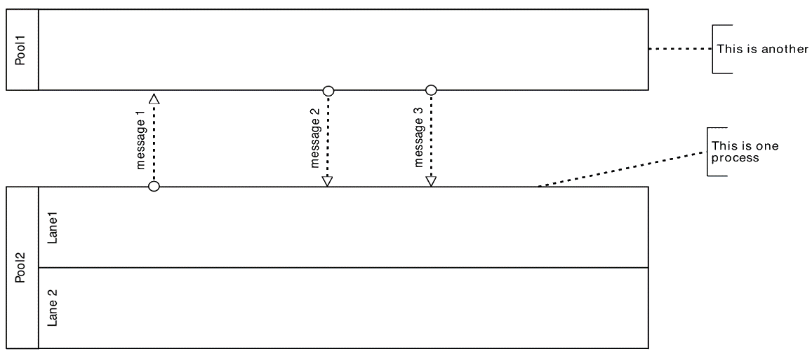
Notation – Lanes & Pools

Slide 29
Order Management Process in BPMN
Integrating Pools & Lanes
Notes:
The Order Management process now includes the customer as a process participant…
The Order Management process is started when a customer places a purchase order. The purchase order has to be checked against the stock re the availability of the product(s). Depending on stock availability the purchase order may be confirmed or rejected. If the purchase order is confirmed, the goods requested are shipped and an invoice is sent to the customer. The customer makes then makes the payment.
Note that pools can be left partially unspecified.

Slide 30

Types of Resources
Data Objects are a mechanism to show how data is required or produced by activities.
Are depicted by a rectangle that has its upper-right corner folded over.
Represent input and output of a process activity.
Data stores are containers of data objects that need be persisted beyond the duration of a process instance
Associations are used to link artifacts such as data objects and data stores with flow objects (e.g. activities).
Data Store

Slide 31
Order Management Process in BPMN
Adding Resources
Notes:
The Purchase Order document serves as an input to the stock availability check. Based on the outcome of this check, the status of document is updated, either to “approved” or “rejected”.
We include here the relevant documents in the process model.

Slide 32
BPMN Exercise 01
Claims Handling process at a car insurer
A customer submits a claim by sending in relevant documentation. The Customer Service department checks the documents for completeness and registers the claim. After registration, the claim is classified leading to two possible outcomes: simple or complex. If the overall claim is simple, the policy is checked. For complex claims, both the policy and the damage are checked independently. The Claims Handling department checks the insurance policy. The same department does the damage assessment. If the overall assessment is positive, the damages are validated and a garage is phoned by the customer service department to authorise the repairs and the payment is scheduled (in this order). In any case (whether the outcome is positive or negative), an e-mail is sent to the customer to notify the outcome.

Slide 33
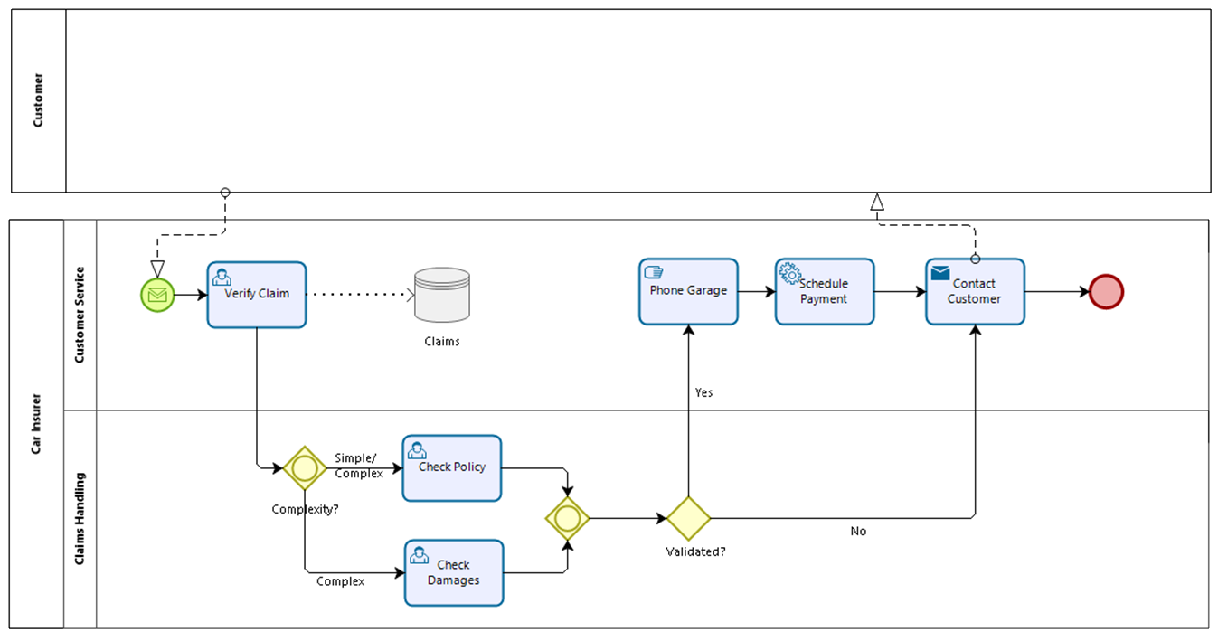
BPMN Exercise 01

Slide 34
BPMN Exercise 02
In the context of a claim handling process, an insurance claim agent needs to verify the policy and an insurance claim agent needs to verify the claimant’s precedents. There is no fixed sequence for these actions. However, at soon as either of these tasks has been performed, the system needs to launch an automated task to add the claim to a daily overview report.

Slide 35
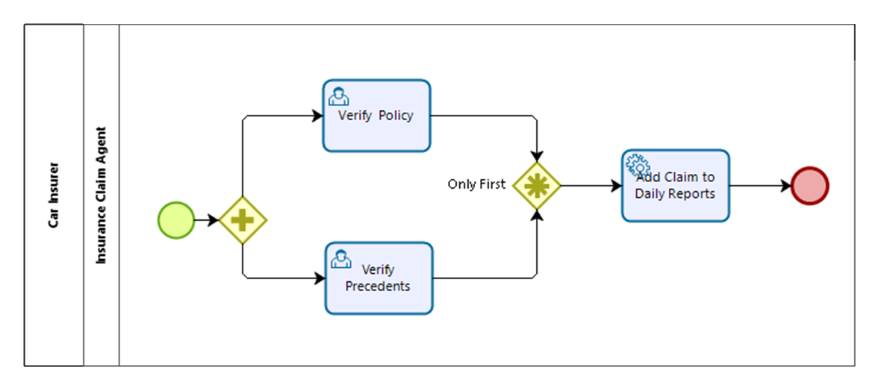
BPMN Exercise 02

Slide 36
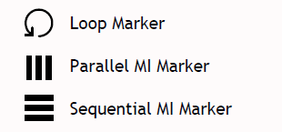
Multiple Instance Markers
“Multiple instance” marker or “parallel repetition” of an activity
Useful when the same activity should be executed for multiple entities or data items, e.g.

Slide 37
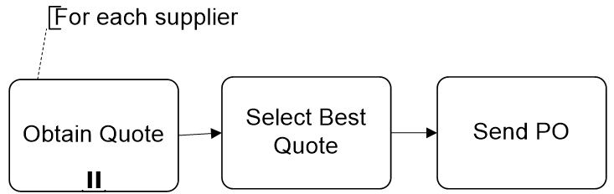
Multiple Instance Markers

Slide 38
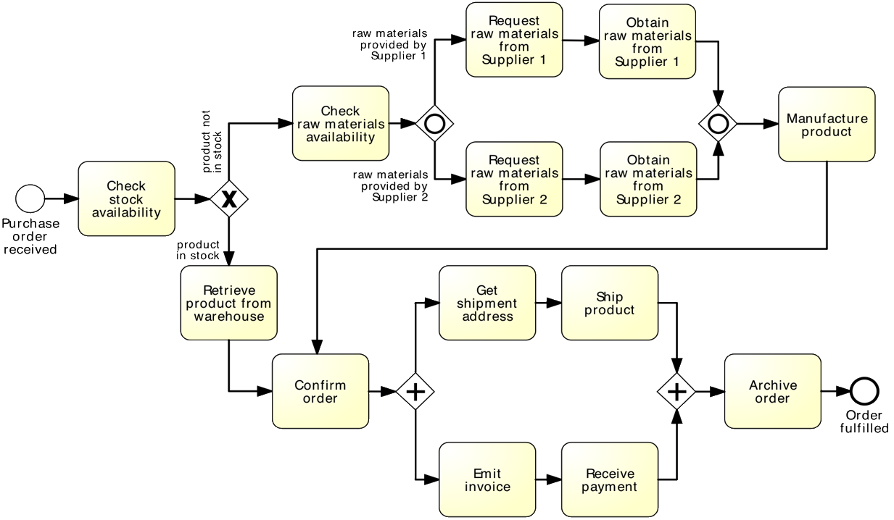
What is Wrong with this Model?

Slide 39
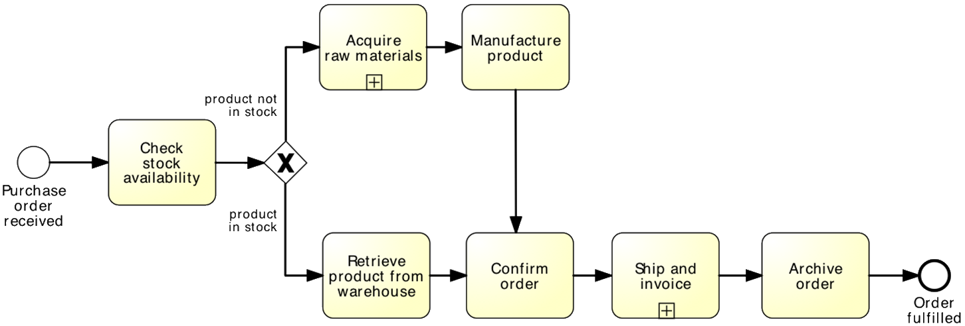
Is This Better?

Slide 40
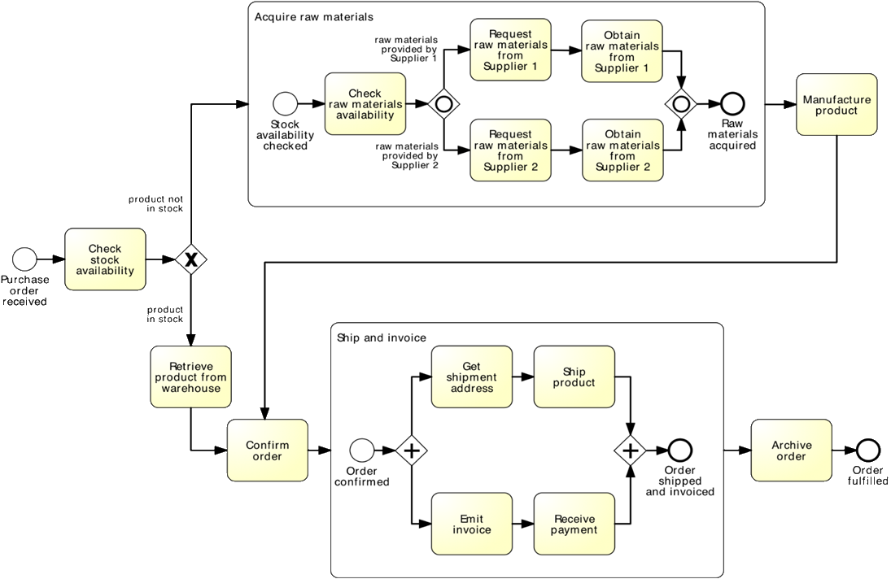
Expanded View

Slide 41
Subprocesses
An activity in a process can “invoke” a separate (sub-)process
Use this feature to:
Break down large models into smaller ones, making them easier to understand and maintain
→ process hierarchies
Share common fragments across multiple processes
→ shared subprocesses
Identify parts of a process that should be:
repeated
executed multiple times in parallel
cancelled

Slide 42
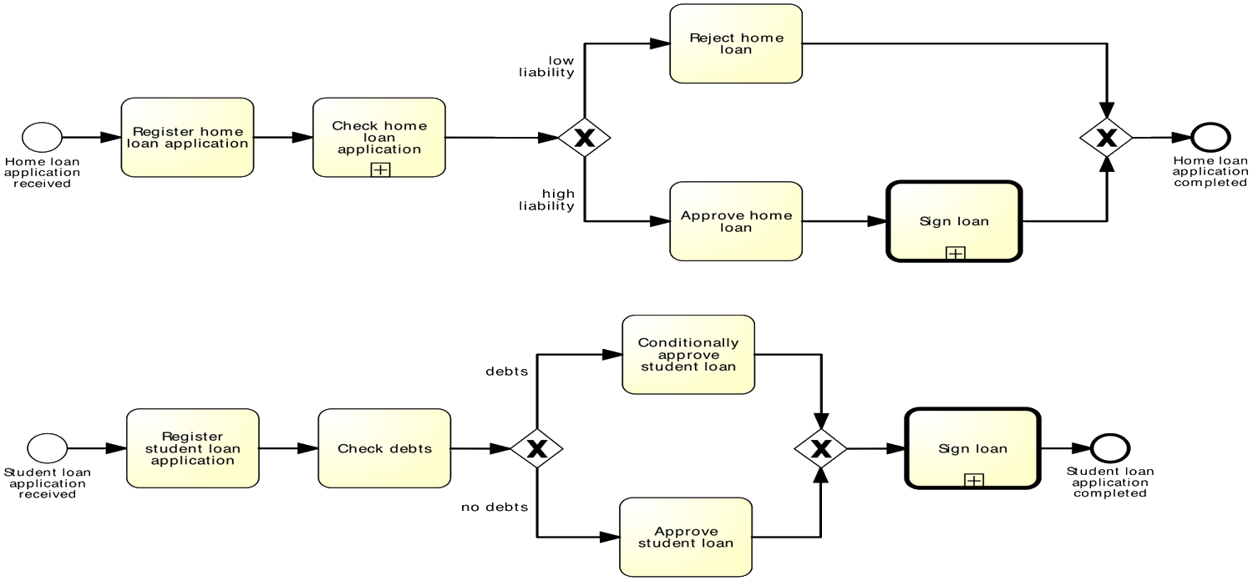
Shared Subprocesses

Slide 43
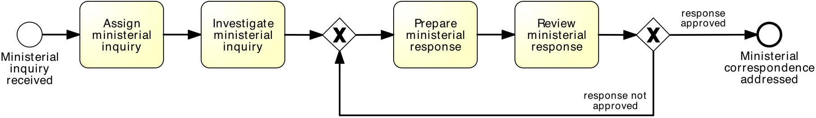
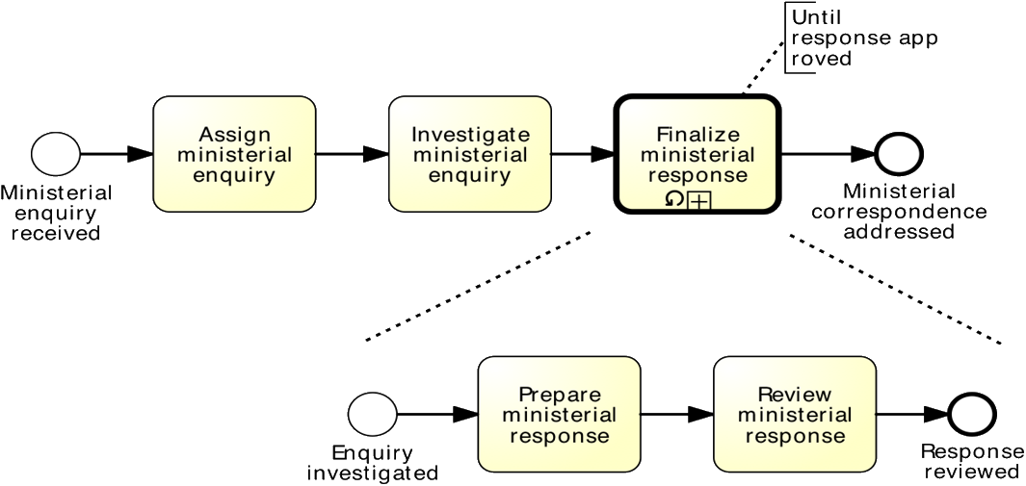
Shared Subprocesses
equivalent to:

Slide 44
BPMN Exercise 03
After a claim is registered, it is examined by two different claims officers. Each claims officer then writes a “settlement recommendation”. These recommendations are checked by a senior claims officer who may mark the claim as “OK” or “Not OK”. If the claim is marked as “Not OK”, it is sent back to the claims officers and the examination is repeated. If the claim is marked as “OK”, the settlement to the customer.

Slide 45
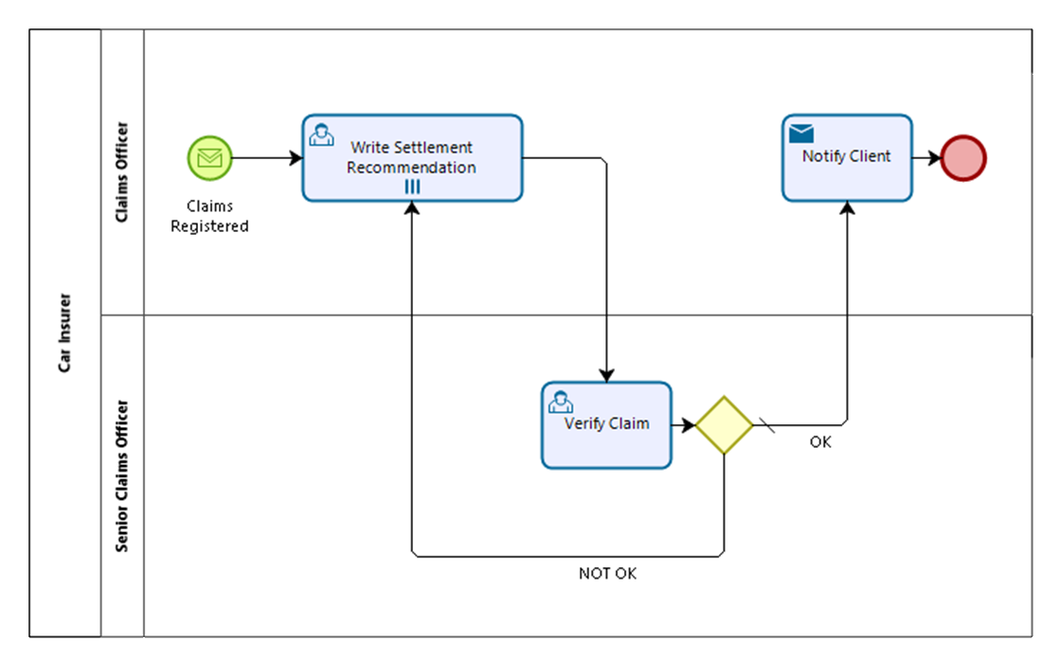
BPMN Exercise 03

Slide 46
Process analysis and optimization

Slide 47
Identifying bottlenecks and inefficiencies
Identifying bottlenecks and inefficiencies in a process involves analyzing the process to identify the steps that take the most time, require the most resources, or cause delays or errors.
This can be done by creating a process map or flowchart that visually represents the process and its steps.
Once bottlenecks and inefficiencies have been identified, optimization can begin.

Slide 48
Identifying bottlenecks and inefficiencies
The following are some ways in which processes can be optimized:
Eliminating unnecessary steps.
Automating certain tasks.
Reducing cycle time.
Improving quality.
Reorganizing the process.

Slide 49
Quantitative and qualitative analysis techniques
Quantitative and qualitative analysis techniques are used in Business Process Modeling (BPM) to analyze and evaluate business processes.
Both quantitative and qualitative analysis techniques are valuable in BPM and can be used in combination to provide a more complete understanding of a process.
Quantitative analysis can provide a high-level view of a process, while qualitative analysis can provide insights into the human factors and subjective experiences that affect the process.
By using both quantitative and qualitative analysis techniques, organizations can gain a more comprehensive understanding of their processes and make more informed decisions to improve them.

Slide 50
Quantitative and qualitative analysis techniques
Quantitative analysis involves the use of mathematical and statistical methods to analyze data. This includes techniques such as regression analysis, data mining, and simulation.
Quantitative analysis is used to identify trends, patterns, and relationships in data. It provides a structured approach to data analysis, making it easier to draw conclusions and make decisions based on data.
Some examples of quantitative analysis in BPM include measuring cycle time, throughput, and error rates.

Slide 51
Quantitative and qualitative analysis techniques
Qualitative analysis, on the other hand, involves analyzing non-numerical data such as text, images, and audio.
This includes techniques such as content analysis, discourse analysis, and case studies.
Qualitative analysis is used to gain a deeper understanding of a process by exploring the perspectives and experiences of those involved in the process.
It provides a more subjective approach to data analysis, allowing for the exploration of complex issues and nuances.
Some examples of qualitative analysis in BPM include conducting interviews, focus groups, and observations.

Slide 52
Process improvement strategies
Process improvement strategies are used in Business Process Modeling (BPM) to optimize business processes and increase efficiency.
The following are some common process improvement strategies:
Lean Six Sigma
Lean Six Sigma is a methodology that combines Lean principles (which focus on eliminating waste) with Six Sigma (which focuses on reducing defects). This methodology aims to create a process that is both efficient and effective, by eliminating waste and reducing variability in the process.
Total Quality Management (TQM)
TQM is a management approach that focuses on continuous improvement of quality in all aspects of an organization. It involves a customer-centric approach and emphasizes the importance of involving employees in the improvement process.

Slide 53
Process improvement strategies
Business Process Reengineering (BPR)
BPR involves a radical redesign of a process to achieve significant improvements in performance. This approach is best suited for processes that are highly inefficient, complex, or outdated.
Kaizen
Kaizen is a Japanese term that means "continuous improvement." This approach involves making small, incremental improvements to a process over time. It emphasizes the importance of involving employees in the improvement process and creating a culture of continuous improvement.

Slide 54
Process improvement strategies
Agile
Agile methodologies are used in software development to create flexible, iterative processes that can respond quickly to changes in requirements.
This approach emphasizes collaboration, customer feedback, and rapid iteration.
Process Mapping
Process mapping involves creating a visual representation of a process to identify inefficiencies, bottlenecks, and areas for improvement.
This approach is useful for understandinghow a process works and for visualizing the steps involved in the process.

Slide 55
Process improvement strategies
Automation
Automation involves using technology to automate certain tasks in a process.
This can help to reduce errors, increase speed, and free up employees to focus on more high-value tasks.
Outsourcing
Outsourcing involves hiring a third-party provider to perform certain tasks in a process.
This approach can help to reduce costs, improve quality, and increase efficiency.

Slide 56
Process improvement strategies
Standardization
Standardization involves creating standard operating procedures (SOPs) for a process.
This approach ensures consistency and reduces the risk of errors or variations in the process.
Overall, process improvement strategies are used to optimize business processes and increase efficiency.
By selecting the right strategy for a particular process, organizations can improve their operations, reduce costs, and gain a competitive advantage in the marketplace.

Slide 57
Capturing integration requirements

Slide 58
Identifying integration points
Identifying integration points is an important step in Business Process Modeling (BPM) because it enables organizations to understand how different systems and processes work together and where integration is needed.
The following are some steps that can be taken to identify integration points:
Identify the processes
The first step is to identify the processes that are critical to the organization's operations. This involves reviewing existing processes and identifying the inputs, outputs, and dependencies of each process.
Identify the systems
The next step is to identify the systems and applications that support each process. This includes on-premise systems, cloud-based systems, and third-party applications.

Slide 59
Identifying integration points
Map the process flows
Once the processes and systems have been identified, the next step is to map the process flows.
This involves creating a visual representation of the process, including the inputs, outputs, and steps involved in the process.
Identify the data requirements
As part of the process mapping, it's important to identify the data requirements for each process.
This includes the types of data needed, where the data is stored, and how the data is used in the process.
Identify the integration points
Based on the process flows and data requirements, the next step is to identify the integration points.
This involves identifying where data needs to be shared between systems and processes, and where functionality needs to be shared.

Slide 60
Identifying integration points
Evaluate the integration options
Once the integration points have been identified, the next step is to evaluate the integration options.
This involves assessing the capabilities of the existing systems and applications, and determining whether they can be integrated using existing tools and technologies, or whether new integration tools and technologies need to be implemented.
Develop an integration strategy
Based on the evaluation of integration options, the next step is to develop an integration strategy.
This involves determining the best approach for integrating the systems and processes, taking into account factors such as cost, complexity, and compatibility.

Slide 61
Defining integration requirements and data flows
The following are some steps that can be taken to define integration requirements and data flows:
Identify the integration points
Define the data requirements
Define the data sources
Define the data flows
Define the integration requirements
Develop a data mapping plan
Test and validate the integration
Document the integration requirements and data flows

Slide 62
Tools for business process modeling

Slide 63
Criteria for selecting a BPM tool
Functionality
Ease of use
Scalability
Integration capabilities
Security
Customization
Reporting and analytics
Support and training
Cost
User community

Slide 64
Overview of popular BPM tools
Microsoft Visio
Visio is a diagramming tool that can be used for BPM. It is popular among organizations that already use Microsoft products, as it integrates well with other Microsoft tools.
Visio allows users to create process diagrams, flowcharts, and other visual representations of processes. It also supports process simulation and automation.
Bizagi
Bizagi is a BPM tool that is known for its ease of use and flexibility. It allows users to create process diagrams using a drag-and-drop interface, and it supports process simulation and automation.
Bizagi also has strong integration capabilities, allowing it to integrate with other systems and applications.

Slide 65
Overview of popular BPM tools
ARIS
ARIS is a BPM tool that is known for its robust features and scalability. It allows users to create process diagrams, conduct process modeling, and analyze process performance.
ARIS also supports process simulation and automation. It is widely used in large organizations, particularly in the manufacturing and telecommunications industries.
Signavio
Signavio is a cloud-based BPM tool that is known for its user-friendly design and collaboration features.
It allows users to create process diagrams, conduct process modeling, and analyze process performance.
Signavio also supports process simulation and automation. It is popular among small and medium-sized businesses.

Slide 66
Overview of popular BPM tools
IBM Blueworks Live
Blueworks Live is a cloud-based BPM tool that is known for its ease of use and collaboration features.
It allows users to create process diagrams, conduct process modeling, and analyze process performance. Blueworks Live also supports process simulation and automation.
It has strong integration capabilities, allowing it to integrate with other IBM products and third-party applications.
Camunda
Camunda is an open-source BPM tool that is known for its flexibility and scalability.
It allows users to create process diagrams, conduct process modeling, and analyze process performance.
Camunda also supports process simulation and automation.
It is popular among developers and technical teams, as it offers a high degree of customization and integration capabilities.

Slide 67
Overview of popular BPM tools
Nintex
Nintex is a cloud-based BPM tool that is known for its ease of use and automation capabilities.
It allows users to create process diagrams, conduct process modeling, and automate processes.
Nintex also has strong integration capabilities, allowing it to integrate with other systems and applications.
It is popular among small and medium-sized businesses.

